Slide 1
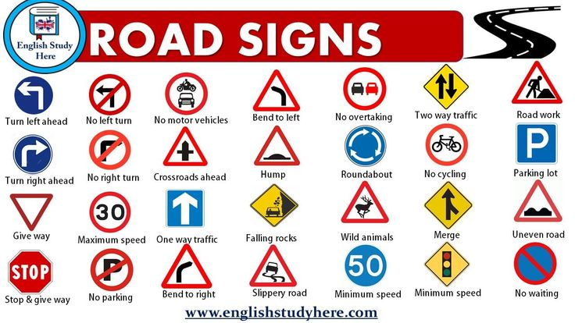
ROADSIGN TAXONOMY
A friendly guide through our roadsign database

Slide 2
Index
A: Danger Warning Signs
B: Priority Signs
C: Prohibitory or Restrictive Signs
D: Mandatory Signs
E: Special Regulation Signs
F: Information, Facilities or Service Signs
G: Direction, position or indication signs
H: Additional Pannels (not any)

Slide 3








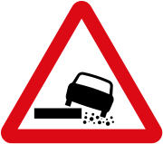
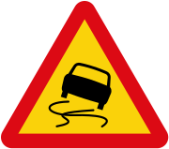
A: Danger Warning Signs
GOAL: serve to alert road users to potential dangerous situations ahead. Their primary goal is to ensure the safety of all road users by providing clear, easily recognizable, and standardized visual cues to help drivers anticipate and react appropriately to upcoming road conditions or obstacles, thereby reducing the risk of accidents and improving overall traffic flow.

Slide 4
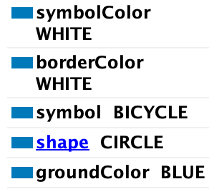
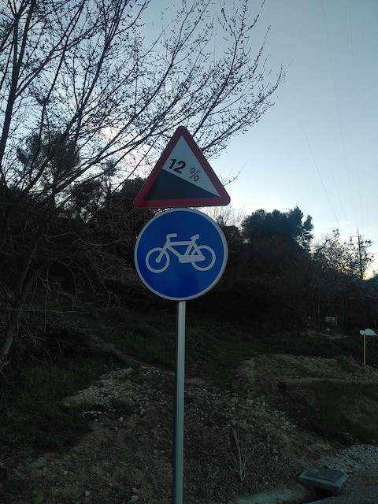
A2: STEEP DESCENT (12%)
A2: Steep Ascent (12%)

Slide 5
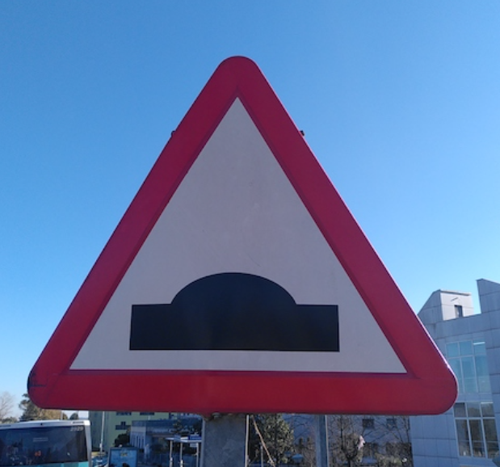
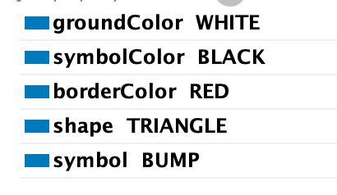
A7: UNEVEN ROAD
A7: uneven road

Slide 6
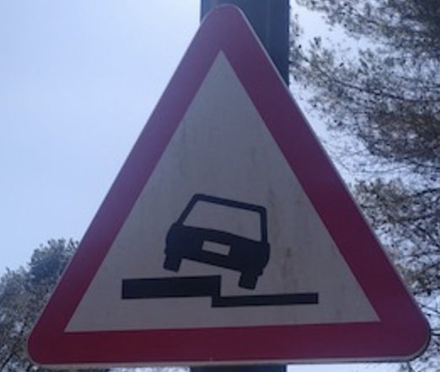
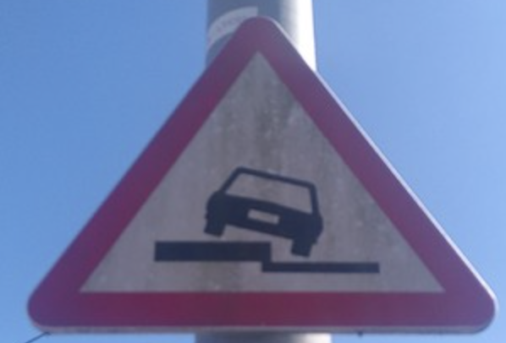
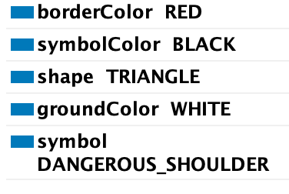
A8: DANGEROUS SHOULDERS

Slide 7
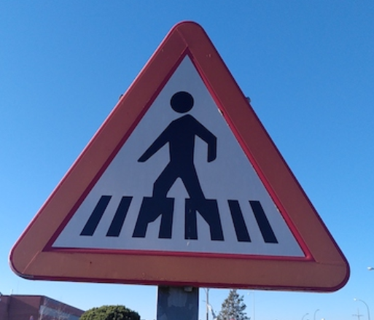
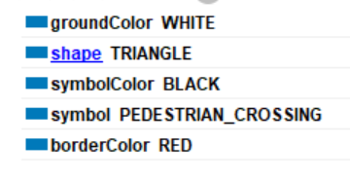
A12: PEDESTRIAN CROSSING
Other Pedestrian crossing:
Photo 2
A12: Pedestrian crossing

Slide 8
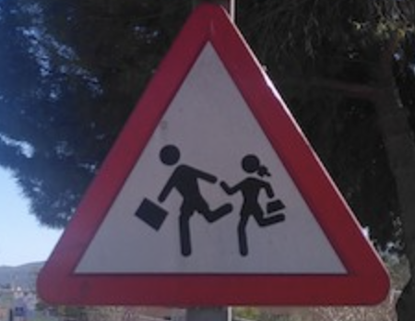
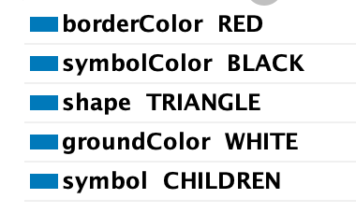
A13: CHILDREN

Slide 9
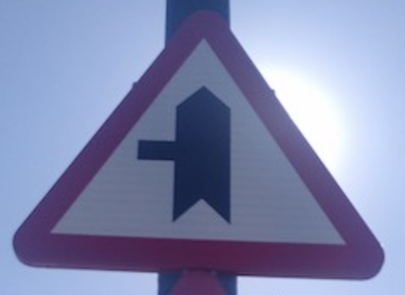
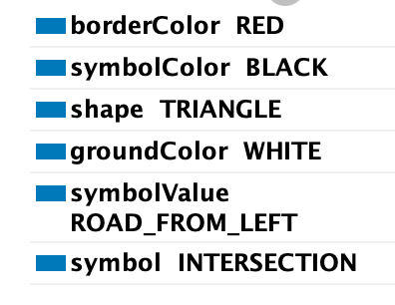
A19: INTERSECTION WITH PRIORITY
Intersection with Priority (left)

Slide 10
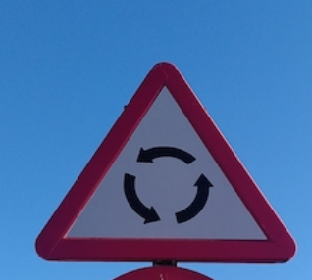
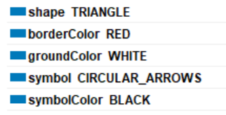
A22: ROUNDABOUT
A22: ROUNDABOUT

Slide 11
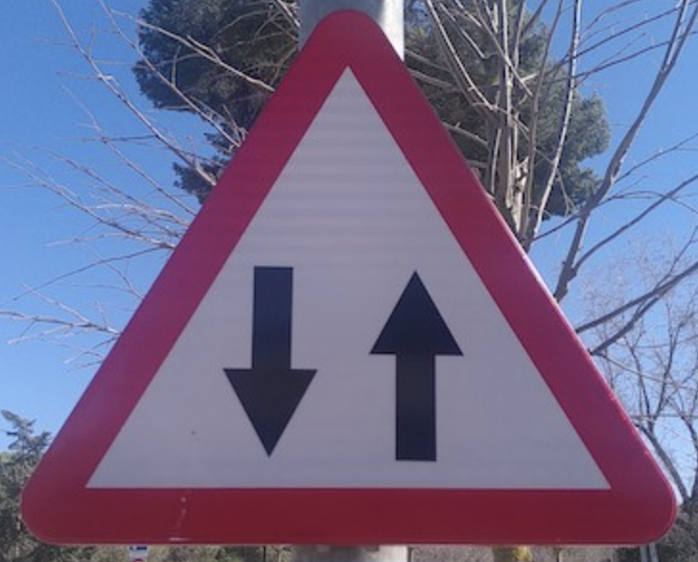
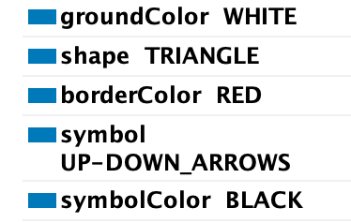
A23: TWO-WAY TRAFFIC
Two-way Traffic

Slide 12

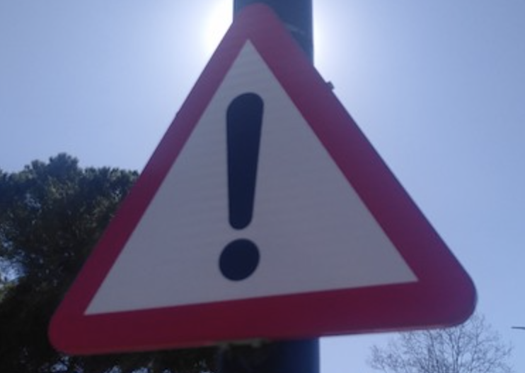
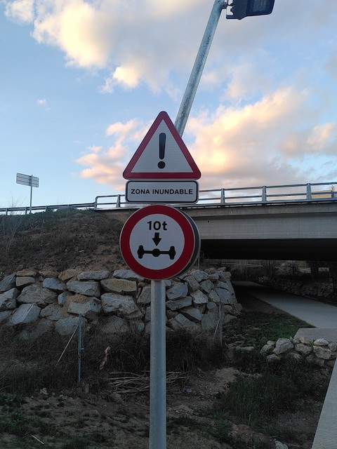
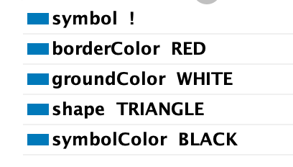
A32: DANGER
A32: DANGER
A32 DANGER

Slide 13
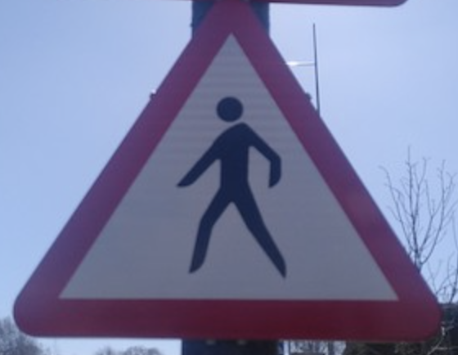
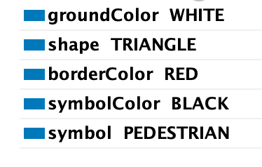
A33: PEDESTRIANS
A33: edestrians

Slide 14





B: Priority signs
GOAL: Serve to establish and communicate the right-of-way rules at intersections or other points where traffic flow might be unclear or conflicting. These signs help maintain an orderly and safe flow of traffic by providing clear guidance on which vehicles have priority in a given situation, reducing the risk of collisions and ensuring smoother navigation for all road users.

Slide 15
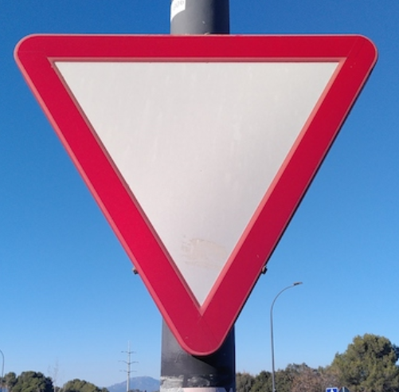
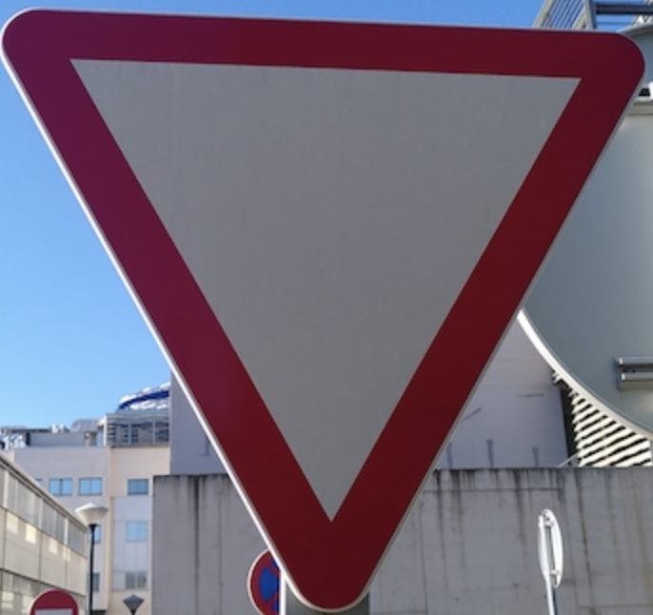
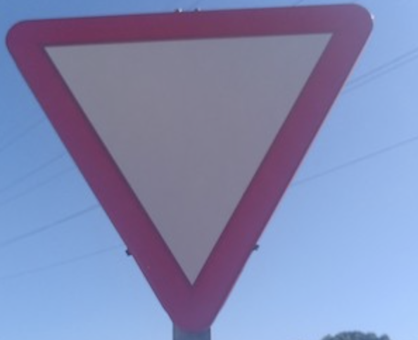
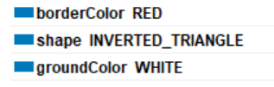
B1: GIVE WAY
B1: Give way

Slide 16
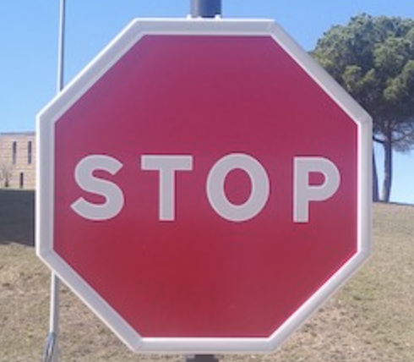
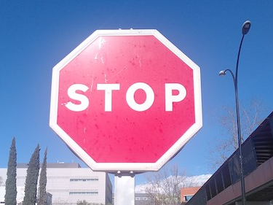
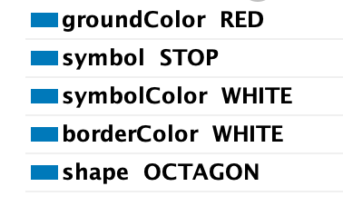
B2: STOP
B2: Stop
B2: Stop(2)

Slide 17






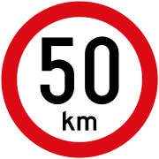



C: Prohibitory or restrictive signs
GOAL: Prohibitory or restrictive signs aim to regulate traffic behavior by prohibiting or limiting certain actions or movements on the road. These signs contribute to road safety and efficiency by enforcing regulations that prevent dangerous situations, maintain an orderly flow of traffic, and protect vulnerable road users. They provide clear instructions to drivers, helping them comply with local rules and avoid potential accidents.

Slide 18
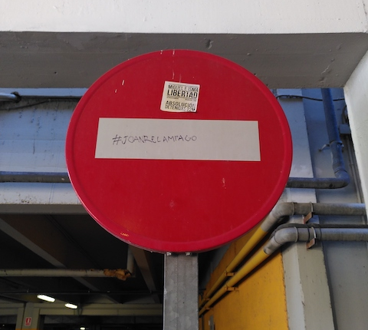
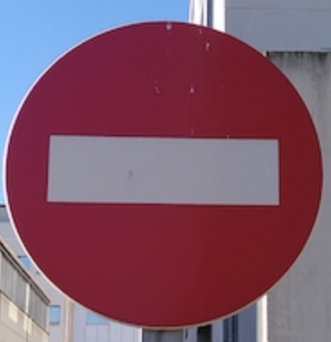
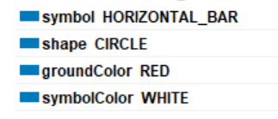
C1a: NO ENTRY
C1a: No entry

Slide 19
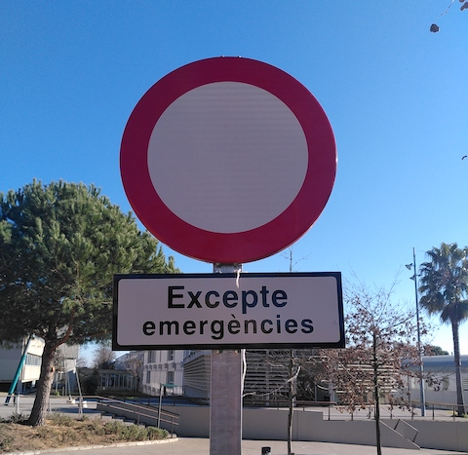

C2: CLOSED TO ALL VEHICLES IN BOTH DIRECTIONS (Excepte emergencies (not taken into account))
C2: CLOSED TO ALL VEHICLES IN BOTH DIRECTIONS (Excepte emergencies (not taken into account))

Slide 20
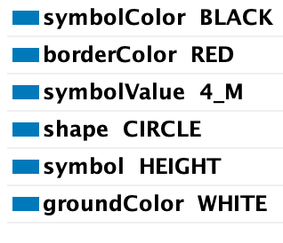
C6: NO ENTRY FOR VEHICLES HAVING AN OVERALL HEIGHT EXCEEDING ... METRES
C6: NO ENTRY FOR VEHICLES HAVING AN OVERALL HEIGHT EXCEEDING 4 METRES

Slide 21
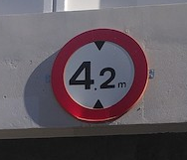
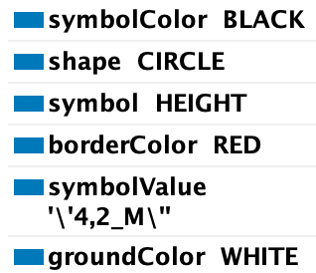
C6: NO ENTRY FOR VEHICLES HAVING AN OVERALL HEIGHT EXCEEDING ... METRES
C6: NO ENTRY FOR VEHICLES HAVING AN OVERALL HEIGHT EXCEEDING 4.2 METRES

Slide 22
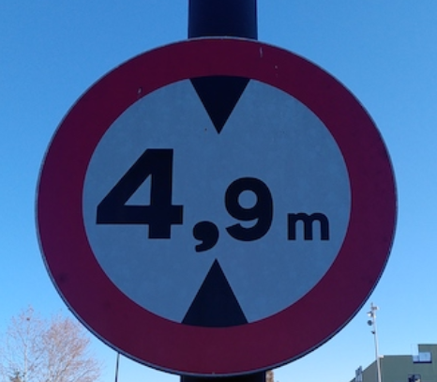
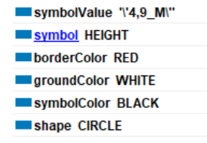
C6: NO ENTRY FOR VEHICLES HAVING AN OVERALL HEIGHT EXCEEDING ... METRES

Slide 23
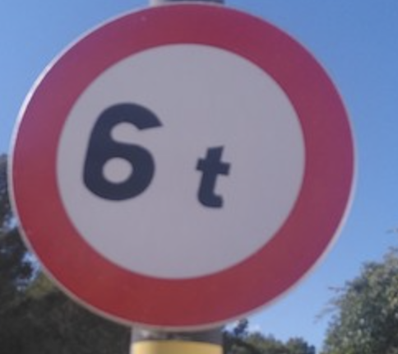
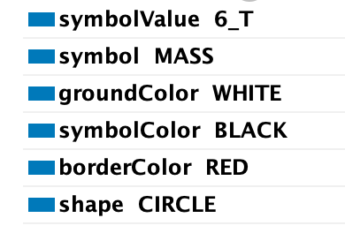
C7: NO ENTRY FOR VEHICLES EXCEEDING ... TONNES LADEN MASS

Slide 24
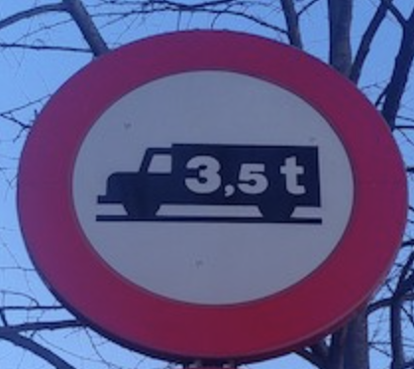
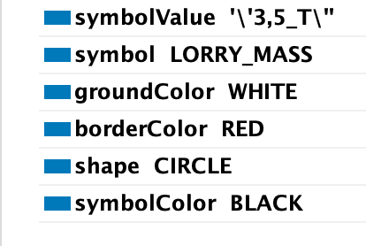
C7: NO ENTRY FOR VEHICLES EXCEEDING ... TONNES LADEN MASS
C7: NO ENTRY FOR VEHICLES EXCEEDING 3. 5 Tones

Slide 25
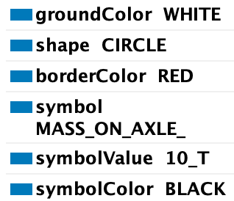
C8: NO ENTRY FOR VEHICLES HAVING A MASS EXCEEDING ... TONNES ON ONE AXLE
C8: NO ENTRY FOR VEHICLES HAVING A MASS EXCEEDING 10 TONNES ON ONE AXLE

Slide 26
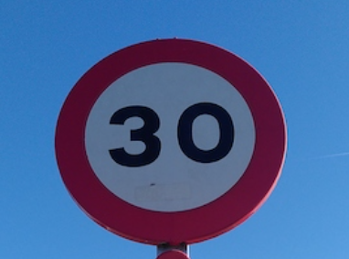
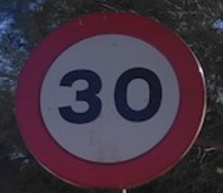
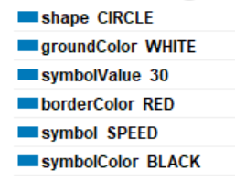
C14: MAXIMUM SPEED LIMIT
C14: Maximum Speed Limit 30

Slide 27


C14: MAXIMUM SPEED LIMIT
C14: Maximum Speed Limit 20

Slide 28


C18: PARKING PROHIBITED
C18 Parking Prohibited

Slide 29








D: Mandatory signs
GOAL: Mandatory signs prescribe specific actions or behaviors that must be followed by road users in designated areas or situations. Their purpose is to enhance road safety, promote efficient traffic flow, and ensure a consistent driving experience. By clearly indicating the required actions, mandatory signs help drivers navigate roads responsibly and comply with local traffic regulations, reducing the risk of accidents and confusion.

Slide 30


D1: MANDATORY DIRECTION (LEFT)

Slide 31


D1: MANDATORY DIRECTION (Right)

Slide 32


D2: PASS THIS SIDE

Slide 33


D3: COMPULSORY ROUNDABOUT
D3: Compulsory roundabout

Slide 34


D4: COMPULSORY CYCLE TRACK
D4: Compulsory cycle track
D4: Compulsory cycle track (2)

Slide 35













E: Special regulation signs
GOAL: Special regulation signs are designed to communicate unique or area-specific traffic rules, restrictions, or information that may not fall under the categories of danger warning, priority, prohibitory, or mandatory signs. Their objective is to enhance road safety, facilitate effective traffic management, and provide important guidance to road users in particular contexts. By clearly conveying localized regulations or conditions, special regulation signs enable drivers to adapt their behavior accordingly and ensure a safe and orderly driving environment.

Slide 36



E12: PEDESTRIAN CROSSING
Other Pedestrian Crossing:
Photo 3

Slide 37


E14: PARKING

Slide 38


E14: PARKING + Motos

Slide 39














F: Information, facilities or service signs
GOAL: Information, facilities, or service signs are designed to inform road users about the availability and location of various amenities, services, or points of interest. Their objective is to enhance the overall driving experience by providing clear and easily recognizable information on facilities such as rest areas, fuel stations, hospitals, tourist attractions, and other essential services. By guiding drivers to these resources, information, facilities, or service signs contribute to a more convenient, comfortable, and safe journey for all road users.

Slide 40


Fn: Firefighter station exit
https://www.iiia.csic.es/~marco/kr/images/IMG_20230202_154357.jpg

Slide 41

Fm: flood zone
Fm: Flood Zone

Slide 42


Fp: Escola de Postgrau
Fp Escola de Postgrau

Slide 43










G: Direction, Position or indication Signs
GOAL: Direction, position, or indication signs provide essential guidance to road users by indicating routes, destinations, distances, or specific locations. Their purpose is to facilitate navigation, promote efficient traffic flow, and ensure a consistent and comprehensible driving experience. By delivering clear and concise visual information, these signs enable drivers to plan their routes, make timely decisions, and reach their desired destinations safely and efficiently.

Slide 44


G2r: Pedestrian Pass
G2r: Pedestrian Pass

Slide 45
ERRORS, ISSUES AND QUESTIONS

Slide 46

Don’t appear in vienna convention

Slide 47


Misclassified
https://www.iiia.csic.es/~marco/kr/images/IMG_20230202_154744.jpg
http://www.iiia.csic.es/~marco/kr/images/IMG_20230202_154744.jpg

Slide 48
Images found in the webpage but not in the protege
https://www.iiia.csic.es/~marco/kr/images/IMG_20230314_145544.jpg

Slide 49
Priority Class
STOP and GIVEWAY → not classified as priority class not defined (not similar properties)

Slide 50
DangerWarningSign (PEDESTRIANS)
PEDESTRIAN → http://www.iiia.csic.es/~marco/kr/images/IMG_20230314_150834.jpg
PEDESTRIAN_CROSSING→ http://www.iiia.csic.es/~marco/kr/images/IMG_20230202_153449.jpg
2 different classes of DWS, or 1 class of DWS, DangerPedestrian, and inside it both of them

